Slide 1
Digital Portfolio
STUDENT NAME: VINOTH KUMAR S
REGISTER NO AND NMID: autunm11024ca120
DEPARTMENT: B.C.A
COLLEGE: DRBCCC HINDU COLLEGE/ MADRAS UNIVERSITY

Slide 2
PROJECT TITLE
PORTFOLIO FOR WEB DEVELOPEMENT

Slide 3


AGENDA
Problem Statement
Project Overview
End Users
Tools and Technologies
Portfolio design and Layout
Features and Functionality
Results and Screenshots
Conclusion
Github Link
3/21/2024 Annual Review

Slide 4

PROBLEM STATEMENT
Need for an online presence to showcase skills and projects.
Difficulty in creating attractive, interactive resumes.
Employers prefer visually appealing portfolios over plain documents.

Slide 5

PROJECT OVERVIEW
Personal portfolio website built with HTML, CSS, and JavaScript.
Modern design with animations and responsive layout.
Showcases skills, projects, and contact details.

Slide 6

WHO ARE THE END USERS?
Recruiters and hiring managers.
Clients looking for web developers.
Tech enthusiasts and peers.

Slide 7

TOOLS AND TECHNIQUES
HTML5 – Structure of the website.
CSS3 – Styling and responsive design.
JavaScript – Interactivity (form validation, animations).
Git & GitHub – Version control and project hosting.
VS Code – Development environment.

Slide 8
POTFOLIO DESIGN AND LAYOUT
Header – Name, tagline, navigation menu.
Sections – About, Skills, Projects, Contact.
Projects Section – Showcases real examples with descriptions.
Footer – Social links (LinkedIn, GitHub, Email).
Responsive Layout – Works on both desktop and mobile.
8

Slide 9
FEATURES AND FUNCTIONALITY
Smooth scrolling navigation.
Responsive design for mobile & desktop.
Interactive project cards.
Contact form with validation.
Integrated social media & GitHub links.
Simple and clean UI for better user experience.

Slide 10
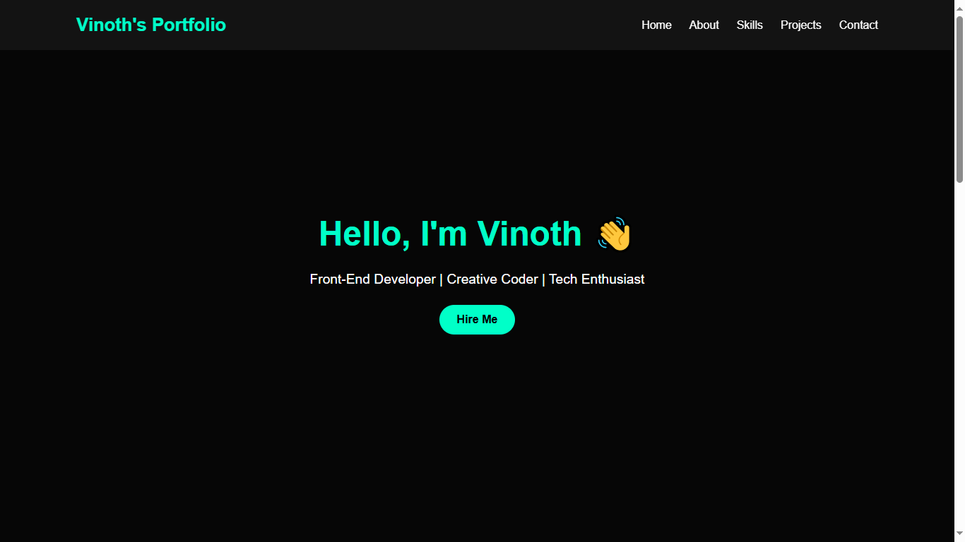

RESULTS AND SCREENSHOTS
3/21/2024 Annual Review
10

Slide 11
CONCLUSION
Successfully built a professional online portfolio.
Enhances personal branding and job opportunities.
Scalable and can be extended with backend integration.
11

Slide 12
Github Link
https://github.com/vinoth-8827/TNSDC-FWD-DP.git

